Slide 1
Spankové problémy
Norbert Matuška

Slide 2
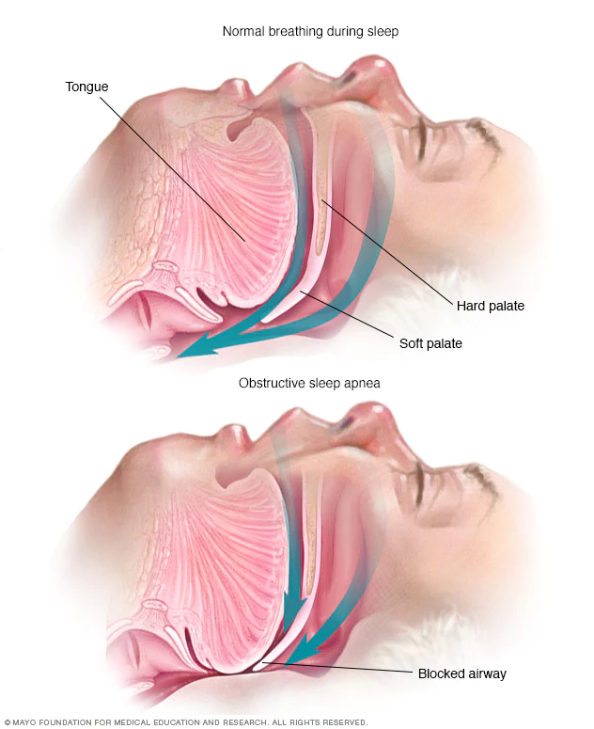
Sleep apnea
Pauses in breathing or periods of shallow breathing
Can last for a few seconds to a few minutes
Snoring and choking or snorting
Disrupts normal sleep -> sleepiness, tiredness
Treatments
1-https://www.mayoclinic.org/diseases-conditions/obstructive-sleep-apnea/symptoms-causes/syc-20352090#dialogId17680496

Slide 3
Sleepwalking
Combined sleep and wakefulness
Occurs during slow wave sleep stage with performance of activities
Talking, sitting up, eating, cleaning
Cooking, driving etc.
Signs and symptoms include
Glassy-eyed stare/pupils dilated
Blank expression
disorientation

Slide 4
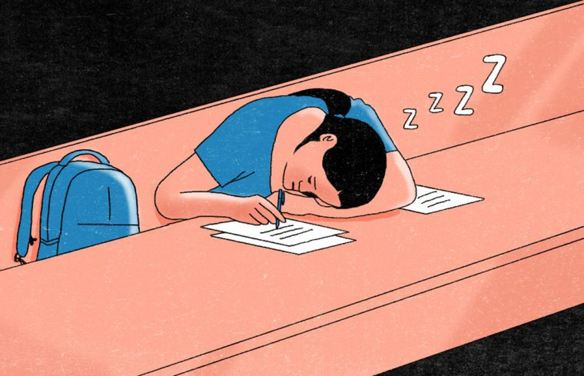
Narcolepsy
long-term neurological disorder
Involves a decreased ability to regulate sleep-wake cycles
Signs and symptoms include
Excessive daytime sleepiness
Brief involuntary sleep episodes
70% experience cataplexy
Less common – hallucinations, sleep paralysis
Quality of sleep is lessened
2-https://theswaddle.com/what-its-like-to-live-with-narcolepsy/

Slide 5
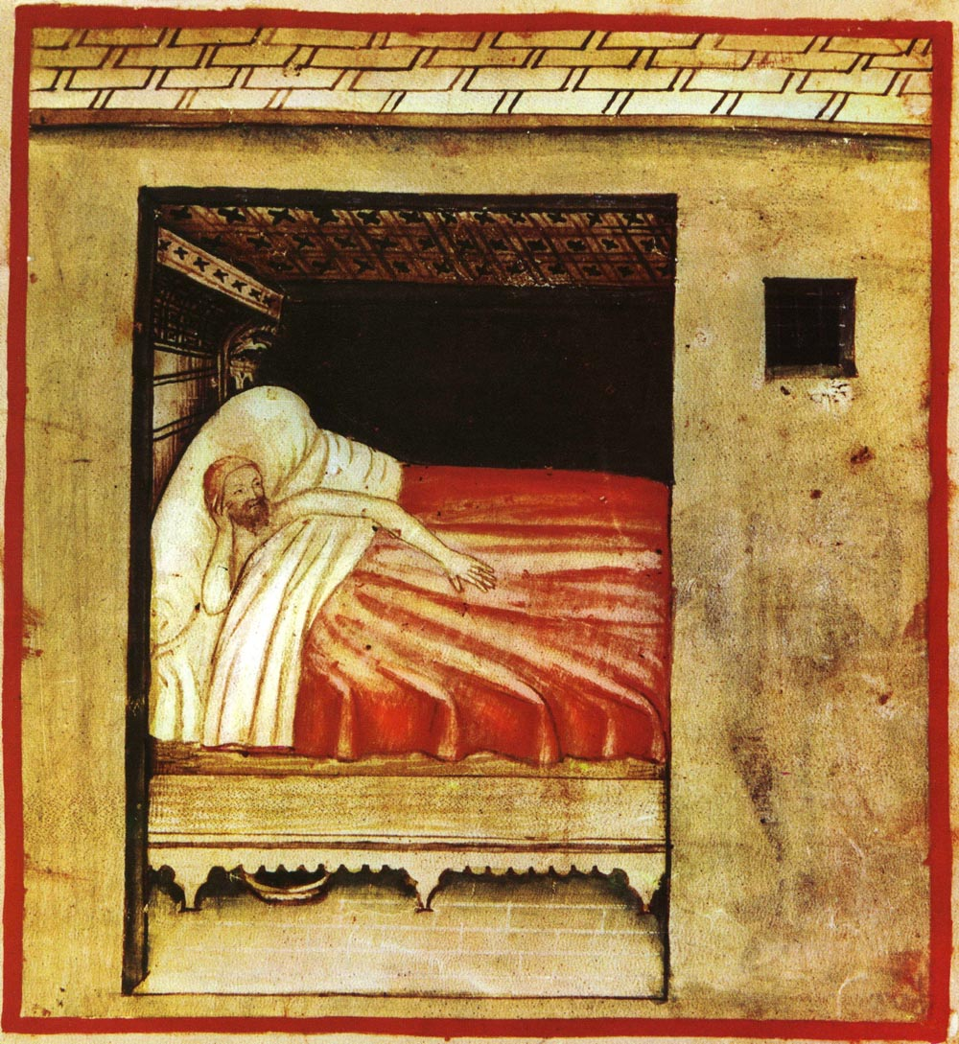
Insomnia
Sleeplessness
Signs and symptoms include
Daytime sleepiness
Low energy
Irritability
Depressed mood
May result in
Motor vehicle collisions
Problems focusing and learning
psychological stress, chronic pain, heart failure, heartburn, restless leg syndrome
Can be short term – days or weeks, or long term – more than a month
3-https://en.wikipedia.org/wiki/Insomnia

